Slide 1
Impact of frequency of floodings on plant populations
A biological model as part of the THEE research practical
Ramin Dürst & Matthias Schönholzer

Slide 2
Biological scenario
Plant population in a river meadow
Two Genotypes:
Wild-type: suffers from flooding
Mutant: benefits from flooding
Increase of flooding events due to climate change
Evolutionary rescue

Slide 3
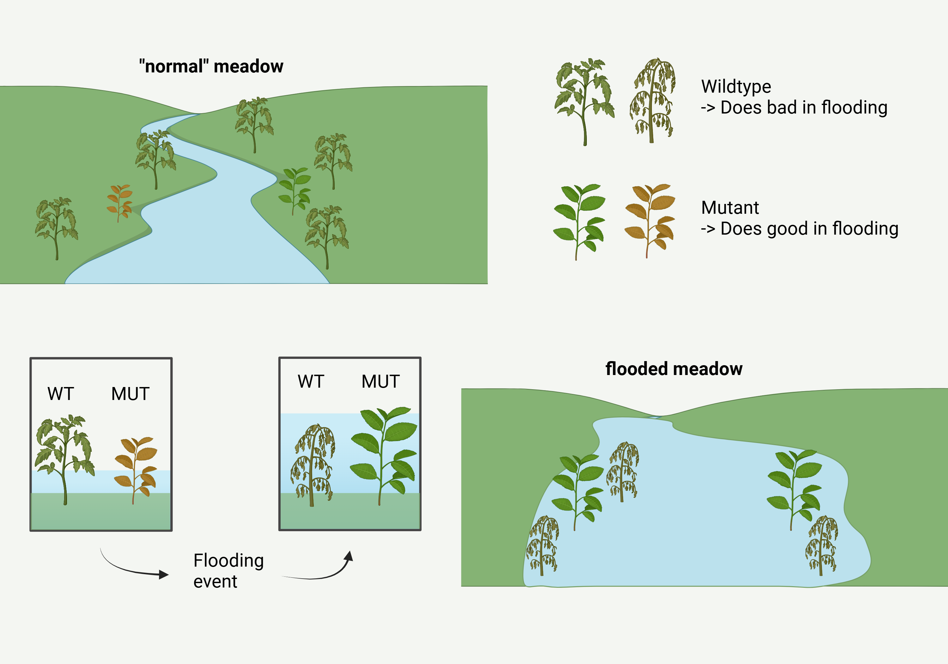

Slide 4
Biological relevance
Climate change increases frequency and intensity of floods

Slide 5
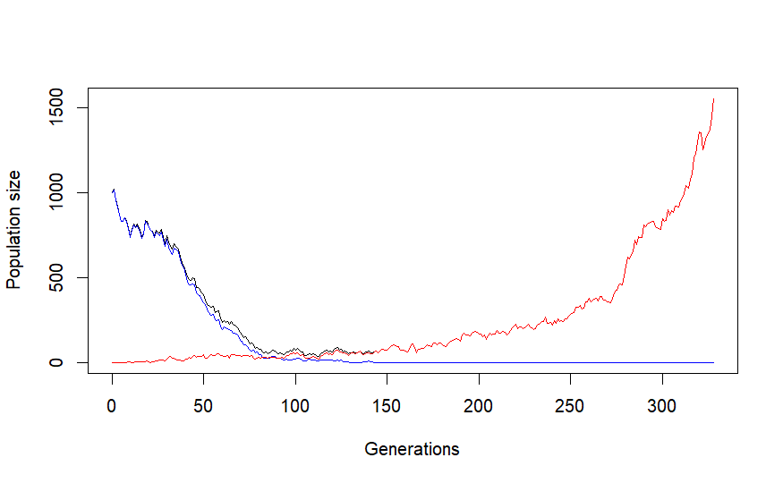
Our model
Simulation of several populations with different frequencies of flooding events
Parameters:
Initial population size
Mutation rate
Duration of flooding event
Variables:
Frequency of events
Decay rate
Selection co-efficient

Slide 6
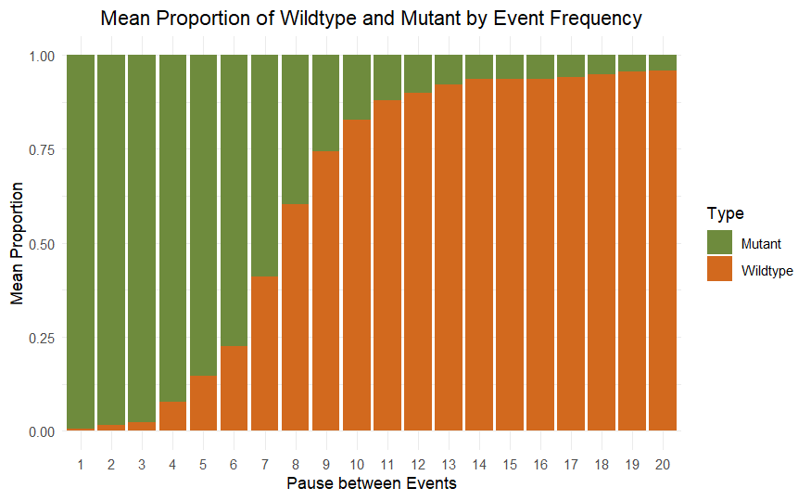
Changes in population composition
Values:
Mutation rate:

Slide 7
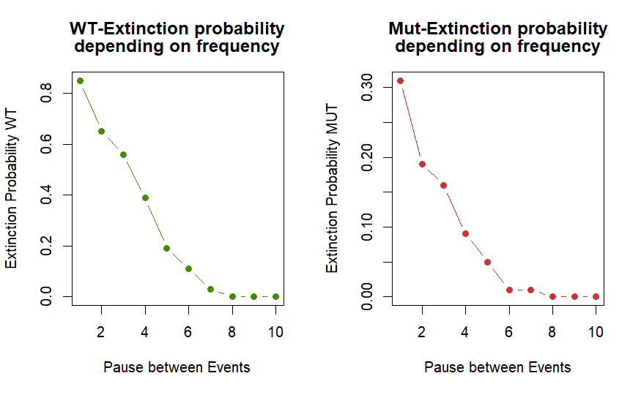
Extinction probabilities

Slide 8
Discussion

Slide 9
Limitations

Slide 10
Next steps

Slide 11
Thank you

Slide 12
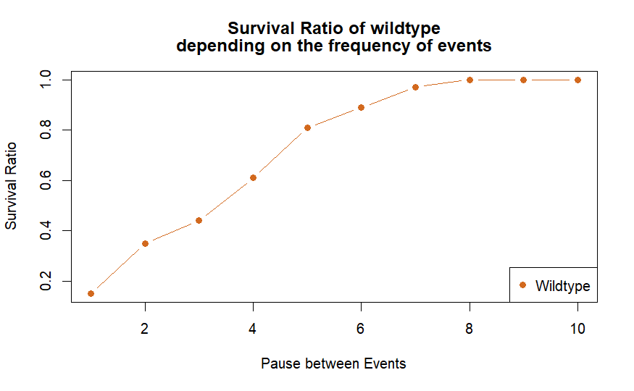

Slide 13
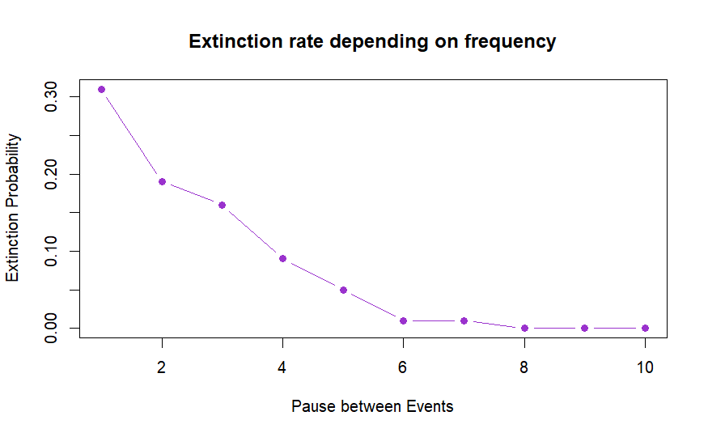

Slide 14
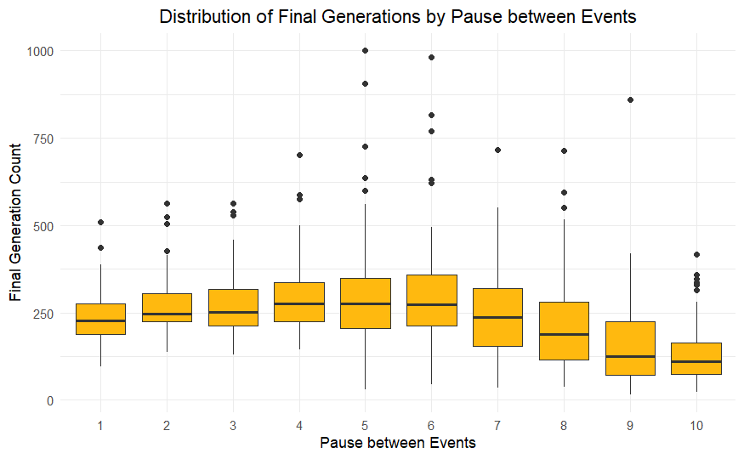

Slide 15
